Slide 1
OWASP Cloud Security
Workshop (2 hours)

Slide 2
Agenda
Workshop introduction - 5 mins
Introduction to Behaviour Driven Development - 10 mins
Group story writing and discussion - 20 mins
Introduction to threat modeling - 10 mins
Group threat modeling and discussion - 20 mins
Using BDD for security - 10 mins
Group threat story writing and discussion - 20 mins
Individual threat story writing - 20 mins
Final remarks - 5 mins

Slide 3
Housekeeping
Session may be recorded and made public
Content produced during session will be published under Creative Commons license
Be mindful of sensitive or proprietary data
Be respectful to each other
If you experience technical difficulties contact ...

Slide 4
Introduction

Slide 5
The OWASP Cloud Security project
Community-driven, open source
Threat and control stories for cloud services
Threats can be used as reference, in threat modeling or just to learn
Controls can be used as reference, to learn or even for continuous testing

Slide 6
Learning objectives
What will the participants get out of the workshop?
Understand the purpose and advantages of BDD
Understand what makes a good story
Get experience writing BDD stories, particularly for security
Understand the purpose and advantages of threat modeling
Understand the basics of threat modeling
Get experience threat modeling a cloud environment
Opportunity to contribute threat and control stories to the OWASP Cloud Security project

Slide 7
Project objectives
What does the project gain from running the workshop?
Contributing back to the community by sharing knowledge and experience
Help grow the project community by raising awareness
Increase the number of contributed threat and control stories

Slide 8
Introduction to Behaviour Driven Development

Slide 9
Testing basics - unit tests
Validate small units of code for correct behaviour
Typically focuses on testing functions
Run locally or continuously as part of a build pipeline

Slide 10
$ vi add.py def add(a, b): return a+

Slide 11
$ python3 add.py File "add.py", line 2 return a+ ^ SyntaxError: invalid syntax
First line of defense (+linting)

Slide 12
$ vi add.py def add(a, b): return a+a

Slide 13
$ vi test_add.py import unittest from add import * class TestAdd(unittest.TestCase): def test_add(self): assert 10 == add(5, 5)

Slide 14
$ python3 -m unittest test_add.py . ---------------------------------------------------------------------- Ran 1 test in 0.000s OK
Not a very good test

Slide 15
$ vi test_add.py import unittest from add import * class TestAdd(unittest.TestCase): def test_add(self): assert 10 == add(5, 5) assert 8 == add(3, 5)

Slide 16
$ python3 -m unittest test_add.py F ====================================================================== FAIL: test_add (test_add.TestAdd) ---------------------------------------------------------------------- Traceback (most recent call last): File "/home/zeroxten/Downloads/src/ocs_workshop/tests/test3/test_add.py", line 7, in test_add assert 8 == add(3, 5)

Slide 17
$ vi add.py def add(a, b): return a+b

Slide 18
$ vi test_add.py import unittest from add import * class TestAdd(unittest.TestCase): def test_add(self): assert 10 == add(5, 5) assert 8 == add(3, 5) assert 0 == add(0, 0) assert 10 == add(15, -5)

Slide 19
$ python3 -m unittest test_add.py . ---------------------------------------------------------------------- Ran 1 test in 0.000s OK
Yay!

Slide 20
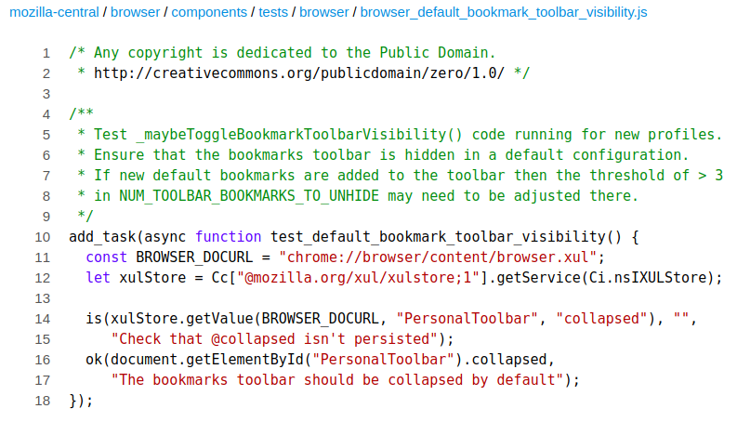
Real world test example
https://dxr.mozilla.org/mozilla-central/source/browser/components/tests/browser/browser_default_bookmark_toolbar_visibility.js
Notes:
https://dxr.mozilla.org/mozilla-central/source/browser/components/tests/browser/browser_default_bookmark_toolbar_visibility.js

Slide 21
Test Driven Development
Turn testing into a development methodology.
Write the tests first
Write the code needed to make the tests pass
Repeat
Tests capture the requirements - ensures it works as intended.

Slide 22
An opportunity beyond TDD?
Test code might need comments to describe the requirements and test. They’re basically written by developers for developers.
What if you need to collaborate or communicate the requirements with others?
Managers; Product owners; Designers; QA; Security; pretty much anyone not familiar with the codebase or programming languages...

Slide 23
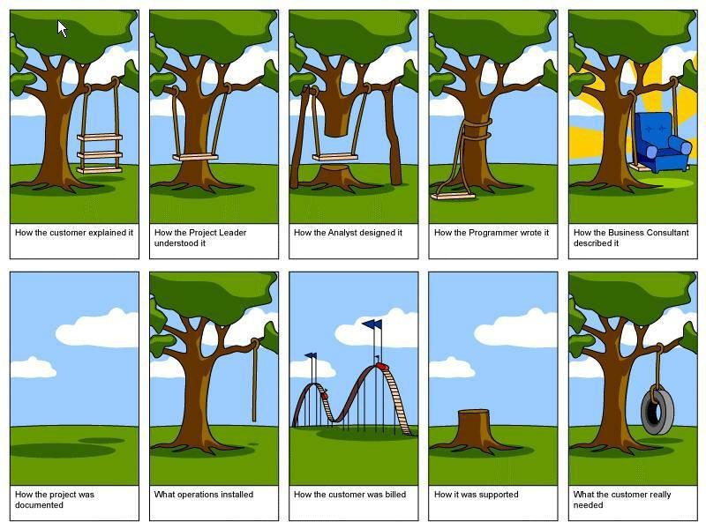
Gathering requirements
https://www.tamingdata.com/2010/07/08/the-project-management-tree-swing-cartoon-past-and-present/

Slide 24
User Stories
A natural way to express “requirements”
“A promise to have a conversation” - Alistair Cockburn
As a web surfer
I want to search Google
So that I can learn new things.
https://automationpanda.com/2017/01/26/bdd-101-the-gherkin-language/

Slide 25
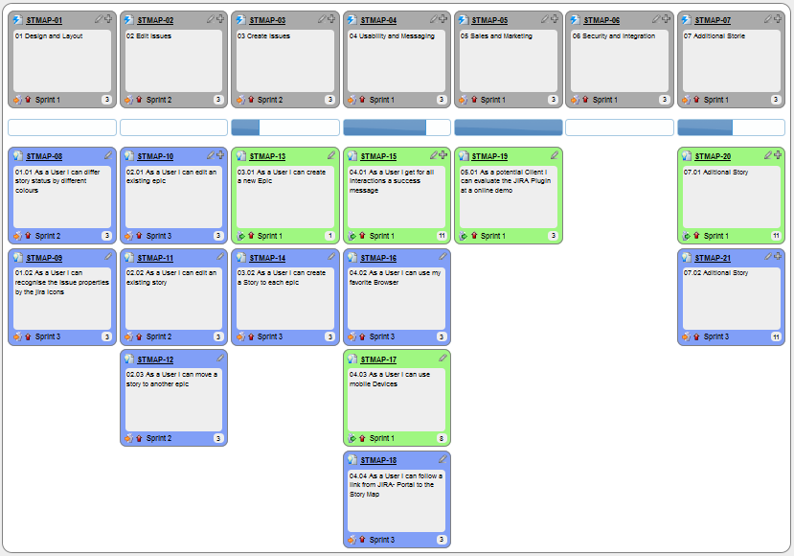
User story mapping
https://upload.wikimedia.org/wikipedia/commons/b/bd/User_Story_Map_in_Action.png

Slide 26
Behaviour Driven Development
Extends user stories with scenarios and steps: The “Feature”
Puts people and desired behaviour at the heart
Features are (more or less) technology agnostic
As much about communication as it is testing

Slide 27
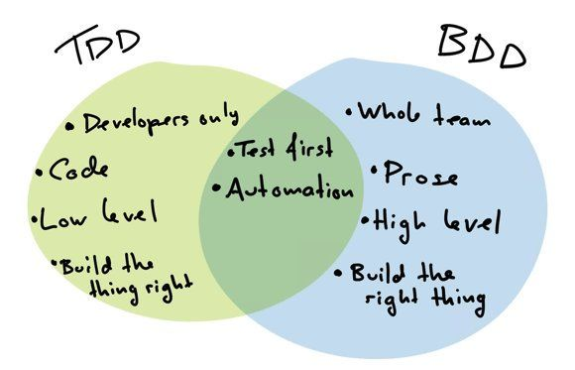
https://twitter.com/cucumberbdd/status/958311085332934657

Slide 28
Example feature
Feature: Google Searching As a web surfer, I want to search Google, so that I can learn new things. Scenario: Simple Google search Given a web browser is on the Google page When the search phrase "panda" is entered Then results for "panda" are shown
The user story. A free-text description of the feature. Generally covers who, what and why, but not necessarily in that order. More than one story is possible.
A free-text description of the test case. A feature can have one or more scenarios. In this case we’re using a BDD language called Gherkin
Scenarios are made up of Given, When, Then statements (also And, But). Each statement is a step that is executed by the BDD framework.
https://automationpanda.com/2017/01/26/bdd-101-the-gherkin-language/

Slide 29
A few more examples...
Feature: Buying food In order to eat, as a citizen, I want to buy food Scenario: Going to the supermarket Given a shopping list of items | item | | milk | | bread | | eggs | And a shopping basket When I add the items to my basket And I pay for the items in my basket Then I can take the items home
A table with one or more columns used in the step above it.
Multiple Givens and Whens combined with And.

Slide 30
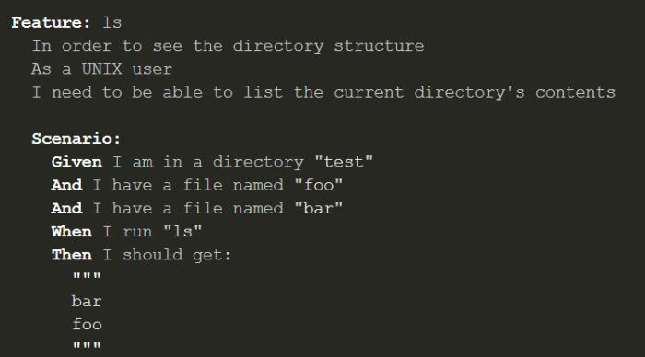
http://media02.hongkiat.com/automated-php-test/bdd-example.jpg

Slide 31
Adding numbers feature
Feature: Adding numbers In order to solve simple maths problems As an engineer I want to add numbers together Scenario Outline: Adding two numbers Given two input integers "<a>" and "<b>" When we add the two numbers together Then the result must equal the integer "<result>"
Examples: Numbers | a | b | result | | 5 | 5 | 10 | | 5 | 3 | 8 | | 15 | -5 | 10 |
Who wants to add numbers, and why?
A Scenario Outline can repeat a scenario for each of the provided examples.

Slide 32
Writing feature steps
import behave from add import * @given('Two input integers "{a}" and "{b}"') def step_impl(context, a, b): context.a = int(a) context.b = int(b) @when('We add the two numbers together') def step_impl(context): context.result = add(context.a, context.b) @then('The result must equal the integer "{result}"') def step_impl(context, result): assert context.result == int(result)

Slide 33
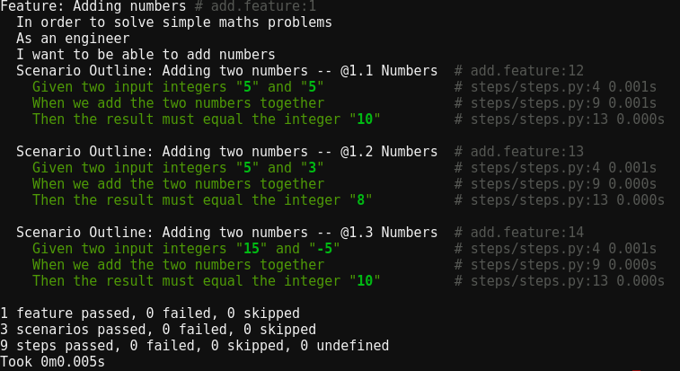
Running a BDD tool

Slide 34
Observations
Takes some time getting used to writing features
… but it starts to feel natural very quickly
Can be hard to balance readability vs detail given the context
… but features can evolve naturally and improve iteratively

Slide 35
Writing good stories
Don’t worry about perfections - just write something
Pretend somebody is standing in front of you and you are casually explaining the subject to them - ELI5
Remember, it’s about communicating an idea - capture the essence of the story to be told
Make sure your “In order to” contains the why and not the how

Slide 36
Hands-on: Group story writing
Making a phone call on a mobile phone
Going to the gym
Connecting to a 3rd party API to validate some data

Slide 37
Example: Making a phone call
Feature: Redial a recent call In order to save time As a mobile phone user I want to call someone I have spoken to recently Scenario: Calling from history Given a phone app showing recent calls When I tap on a call in the list And I tap on the “Call” button Then the phone will immediately start calling the number from the call

Slide 38
Example: Going to the gym
Feature: Going to the gym In order to stay fit and healthy As a busy person I want a quick and comprehensive exercise routine Scenario: Using the resistance equipment Given a resistance exercise machine And instructions for the exercise machine When I correctly follow the instructions And I set the resistance correctly Then I will strengthen and tone the muscle areas indicated

Slide 39
Example: Connecting to 3rd party
Feature: Validate data against 3rd party service In order to ensure data quality and correctness As business analyst I want to the data to be validated Scenario: Successfully validating against the ACME API Given the ACME data validation API And a data object to be validated When call the ACME API And we provide the data to be validated Then the API responds with a “status” of “valid”

Slide 40
Introduction to
Threat Modeling

Slide 41
Threat modeling is the process of understanding and communicating threats and mitigations in the context of something of value, typically applications or services

Slide 42
Why threat model?
Addresses security at a fundamental, architectural level.
Design flaws that turn into vulnerabilities are hard to pick up in code scans.
Help guide and prioritise other controls and make the best use of them. Less reliance on band-aid solutions.
Find problems sooner, fix them sooner, cheaper.
Brings development teams closer to security.
“You can't secure what you don't understand.” - Bruce Schneier, 1999
Notes:
https://www.schneier.com/essays/archives/1999/11/a_plea_for_simplicit.html

Slide 43

Threat modeling is easy (and fun)
You already do it every day, for example when parking your car in a new area.

Slide 44
Vocabulary - Car example
Bug - Window stuck open
Vulnerability - Window glass can be smashed (security/usability tradeoff)
Threat - Car is broken into
Threat actor - Bad dude breaking into cars
Exploit - The brick used
Mitigation - Bulletproof glass, alarm (detective)
Compound threat - Car is broken into and stolen
Risk - Impact: Insured? New car? Inconvenient? Likelihood: Flashy car? Environment

Slide 45
Overview of methodologies
There is no one right way to threat model.
Modeling serves the purpose of simplifying complex things to aid understanding.
Models are never perfect - all models are wrong, some are useful.
Be lean - start simple, try something, learn, tweak, experiment and repeat.

Slide 46
Answer the 4 basic questions
Different methodologies have different approaches, but a good general approach is to ask 4 basic questions:
What are you building?
What can go wrong?
What are you going to do about it?
Are you doing a good job of answering 1 to 3?
Credit: Microsoft & Adam Shostack

Slide 47
What are you building?
Threat modeling sessions should be run by the people doing the building, with support from subject matter experts (e.g. AppSec, Security Architecture) where needed
Decide the scope for the available time - an application, a feature, sub-components, user journey
Understand the targets. Use architecture diagrams, data flow diagrams, network diagrams, sequence diagrams - whatever is appropriate
Define and draw the trust boundaries between components

Slide 48
Get the right people
Someone needs to facilitate the session - keep things on topic, encourage participation
Technical lead(s) who have a deep understanding
As many other engineers from the project as is possible
Someone to write down threats and mitigations
Other SMEs such as security, QA, design

Slide 49
Defining scope
Choose an appropriate scope for the given time (e.g. 2 hours)
If in doubt, start broad and have in-depth follow up sessions
Other choices include focusing on a new feature
Or user journey

Slide 50
Develop a common understanding
Draw the target system or service on a whiteboard
Helps to ensure everyone agrees on what is true
You typically get “that doesn’t connect there anymore” comments
If you’re new to threat modeling, don’t get too hung up on exactly how to draw the diagram - just draw something everyone can understand

Slide 51
Define the trust boundaries
Trust boundaries separate different levels of access, privilege, security
Threats tend to concentrate at trust boundaries
For example; a boundary exists between a user’s browser and the web service they are accessing

Slide 52
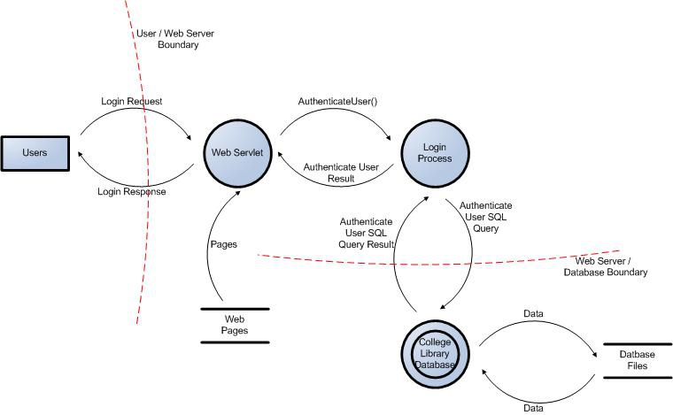
https://www.owasp.org/index.php/Application_Threat_Modeling

Slide 53
What can go wrong?
There are many different approaches and methodologies for identifying threats. STRIDE is a good starting point.
STRIDE
DREAD*
PASTA**
CAPEC
CWEs
OWASP Top 10
Attack libraries

Slide 54
Overview of STRIDE
Spoofing - impersonating an entity or service
Tampering - making unauthorised changes
Repudiation - “wasn’t me”
Information disclosure - getting unauthorised access to information
Denial of service - preventing legitimate access
Elevation of privilege - being able to do things as someone or something else

Slide 55
Example: Using STRIDE
HTTP
Web application
HTTPS
Third-party data API
User
Trust boundary
(Not a DFD)

Slide 56
Spoofing
User authentication; 3rd party API; 3rd party response
Tampering
3rd party data; client-side code; unencrypted user connection
Repudiation
Web app logs; 3rd party logs
Information disclosure
Unencrypted user connection; 3rd party data storage
Denial of service
Web app; 3rd party rate limits;
Elevation of privilege
Code execution in web app; command injection in 3rd party data

Slide 57
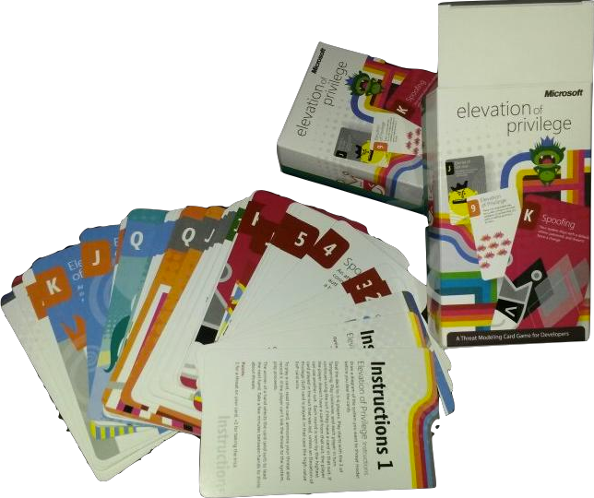
Elevation of Privilege game
A card game based on STRIDE
Threat modeling can be fun! ;)
Threat modeling *should* be fun

Slide 58
What are you going to do about it?
Eliminate - there’s no threat if the component or feature is removed
Mitigate - add preventative, detective or other controls
Transfer - make the risk someone else’s problem (e.g. through legal contract, or physical security for Cloud services)
Accept - don’t do anything about the threat and hope for the best (the default even if you don’t threat model)

Slide 59
Track your threats and mitigations
Don’t threat model for the sake of threat modeling
Use threat modeling to identify threats, then fix them
Use whatever tools you have available or experiment with new tools:
Issue tracker (e.g. JIRA)
Spreadsheets (avoid if possible)
Threat modeling specific solutions

Slide 60
Are you doing a good job?
Creates the feedback loop for continuous improvement
Threat models are living documents and should evolve over time as the applications and features evolve
Have you found all of the threats?
Did you cover the important components?
What’s missing or could be done better next time?
Do you need more time, different people in threat modeling sessions?

Slide 61
Example: Agile threat modeling
Start threat modeling with a one-off session that has broad scope and then don't go too deep.
Use a tool like STRIDE to identify threats and document them so they can be shared.
Identify mitigations and add them to the product backlog.
Prioritise and work on the mitigations as you would any other story, ideally having them as linked acceptance criteria for other feature stories.

Slide 62
Allow a bit of time at the end of the first session to do a brief retro, identify next steps such as a follow up session.
If needed run a separate deep-dive session for complex or security-critical areas.
Once you've got the hang of threat modeling, look at embedding it into the existing development ceremonies. For example, if you're already running architecture/design planning sessions at the beginning of a release, include extra time to threat model the new feature or other changes.

Slide 63
You might also want to include micro sessions in a more regular basis, e.g. during sprint planning or ad-hoc after a stand up. 10 minutes might be enough to identify a critical threat early on.
The product owner should only accept feature stories if all the related threat mitigation stories are also complete.
Find a time to review the approach to threat modeling and methodology, scope coverage, types of threats identified, outstanding mitigations etc. Also think about whether the environment has changed.

Slide 64
In parallel to the above, ensure that the threat models, threats and mitigations are visible to the security SMEs so that they can review to identify areas that might need further focus, and to offer their expertise when needed.
Be lean in your approach - start simple; measure success, e.g. through pentest results; if something isn’t working, experiment; teach and share with the community.

Slide 65
Hands-on: Group threat model
Simple 3-tier website
Mobile phone privacy
Using an online password manager

Slide 66
Example: 3-tier website

Slide 67
Example: Mobile phone privacy

Slide 68
Example: Password manager

Slide 69
Using BDD for Security

Slide 70
WARNING
Parts of this next section are highly opinionated.
You might not agree with everything, and that’s cool.

Slide 71
Why use BDD for security?
Security is just a branch of Quality Assurance (QA), applied to adversaries instead of systematic and random failures.
Can we use some of the same tools from testing and QA and apply them to security?
If you can use BDD to specify and test a feature, why not use BDD to specify and test a security feature.
Security concepts and threats need to be shared and communicated - ideal use case for BDD
Developers writing security tests scales

Slide 72
BDD for threat modeling
User stories and BDD all about having a conversation, shared understanding, action
Threat modeling is all about having a conversation, shared understanding, action

Slide 73
Traditional security policy vs BDD
Traditional
BDD
Ambiguously-worded
Word documents nobody reads
Static and already out of date
Out of sync with reality
Written in a way understood by everyone
Can live alongside code e.g. in Git
Easy and transparent updates
Continuously testable!

Slide 74
A brief history of BDD for security
Early 2012 saw the creation of the two best known projects: BDD-Security and GAUNTLT
Both use BDD to describe the security behaviour (good or bad)
Both tools are open source (free as in beer and speech)
The beginning of DevSecOps or SecDevOps - embedding security testing into the CI/CD pipelines
Typically focuses on application behaviour: listen on the right ports; correct authentication patterns; correct use of crypto

Slide 75
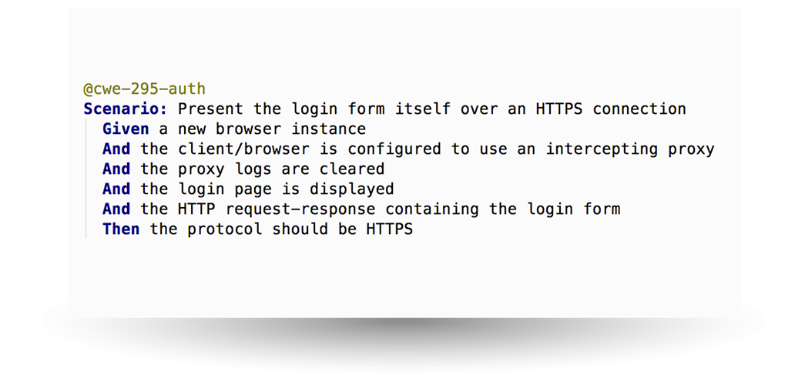
BDD-Security example
https://www.continuumsecurity.net/bdd-security/

Slide 76
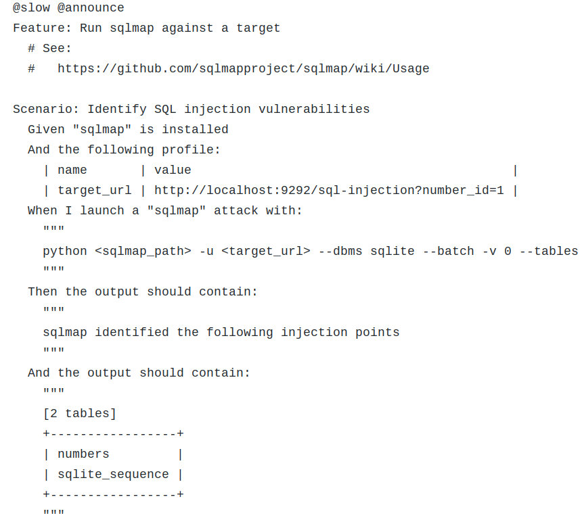
GAUNTLT
example
https://github.com/gauntlt/gauntlt/blob/master/examples/sqlmap/sqlmap.example

Slide 77
We want to… write a threat story
Describe the attack from an attackers perspective
Explain why the attacker would carry out the attack
Provide one or more scenarios that describe ways the attack can occur

Slide 78
Threat story example: SQLi
Feature: SQL Injection In order to retrieve the contents of the database, As an attacker, I want the web application to insufficiently validate user input Scenario: Timing based blind injection Given a web form with text input fields When we enter the value “test+SLEEP(30)” in one of the fields And we submit the form Then the “SLEEP(30)” function should execute And the form should respond after “30” seconds

Slide 79
SSH brute force
Feature: SSH brute force In order to get shell access to a system, As an attacker, I want the system to use weak authentication Scenario: Online password brute force Given a system running an accessible SSH daemon And a wordlist of users And a wordlist of passwords When we SSH to the system using each combination of username and password Then we should get shell access to the system

Slide 80
Phishing
The threat
Feature: Phishing corporate users In order to bypass the security perimeter, As an attacker, I want users to visit a malicious URL sent via email Scenario: Targeted phishing Given background information on the target And a convincing email template using background information And a convincing website URL that executes a malicious payload And the email is sent to the target email recipients When the user reads the email And the user clicks on the link Then the payload should execute And we should get code execution on the user’s machine
Attack scenarios

Slide 81
What about Cloud?
So far DevSecOps has been mostly focused on testing application code (SAST, DAST etc.) and behaviour, particularly in CI/CD pipelines.
But what about in a Cloud world where everything is code?

Slide 82
The OWASP Cloud Security project
Recap:
Help people secure their products and services running in the cloud
Focuses on cloud services (APIs)
Threats and mitigating controls expressed as Gherkin stories
Pool together the expertise and experience of the community around breaking and securing cloud services

Slide 83
Using the project
The two main uses of the project are:
Using the threat stories in threat modeling sessions
Using the control stories for continuous testing of mitigations

Slide 84
Using the threat stories
In order to improve the security of systems and services
As a subject matter expert
I want to share possible threats

Slide 85
Using the control stories
In order to improve the security of systems and services
As a subject matter expert
I want to share possible mitigations that others can implement

Slide 86
Threat Modeling Walk-Through

Slide 87
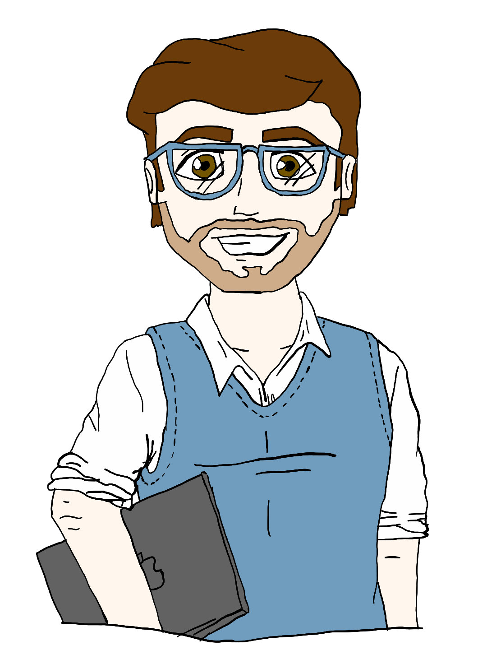
This is Mark. He’s a developer.
Profile
Working to tight deadlines
Needs to get something working asap
Will have to support services once live
Loves full-stack work
New to cloud
Always considers end users, accessibility champion
Image credit: Rebecca Manning

Slide 88
Mark’s task
Feature:
In order to ensure the quality of 3rd-party data submissions
As a business analyst
I want a data parsing and validation engine
Requirements:
Web-based API to replace existing system
Validate subset of the data against our 3rd-party partner
Transform and scrub data where needed
Write processed data objects to S3 so new backend process can pick them up

Slide 89
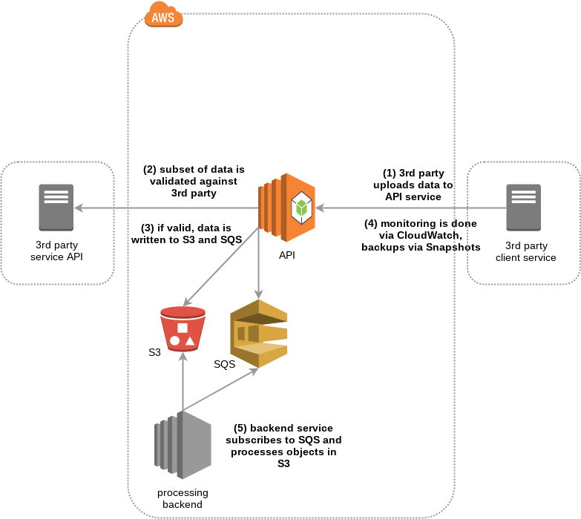

Slide 90
Hey Tara. Would you mind taking a look at this design with me? I’d love to know whether I’m missing any key operational things.

Slide 91

This is Tara. She’s an operations engineer.
Profile
Loves metrics and graphs
Big fan of IaC and config management
Works closely with devs, helping them to automate deployments etc.
Believes containers are the future
Moto is “Fail fast, fail often”
Image credit: Rebecca Manning

Slide 92
This looks great Mark. How are you doing monitoring, logging and backups?
Not sure yet. Is there a cloud service I could be use?
Of course! You can use CloudWatch for monitoring and logging, and Snapshots for backups. Something like this….

Slide 93
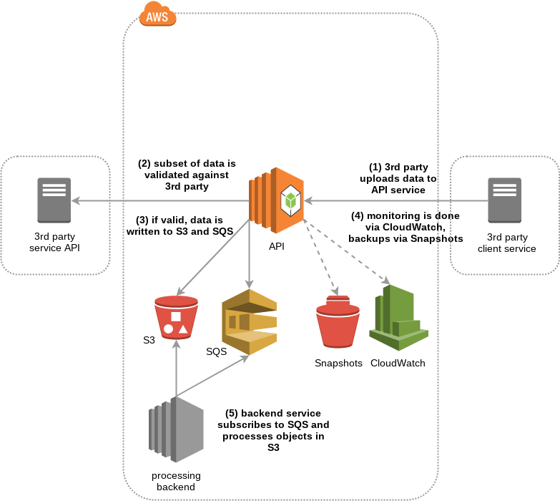
Let’s add the ops stuff

Slide 94
Hmmm. Some of the data we’re handling is pretty sensitive. Do you think it looks ok in terms of security?
I can’t see anything obviously bad. Perhaps we can ask Emily to take a look. She works in the security team.
Great! I don’t really know anyone in that team. Thanks for helping.

Slide 95
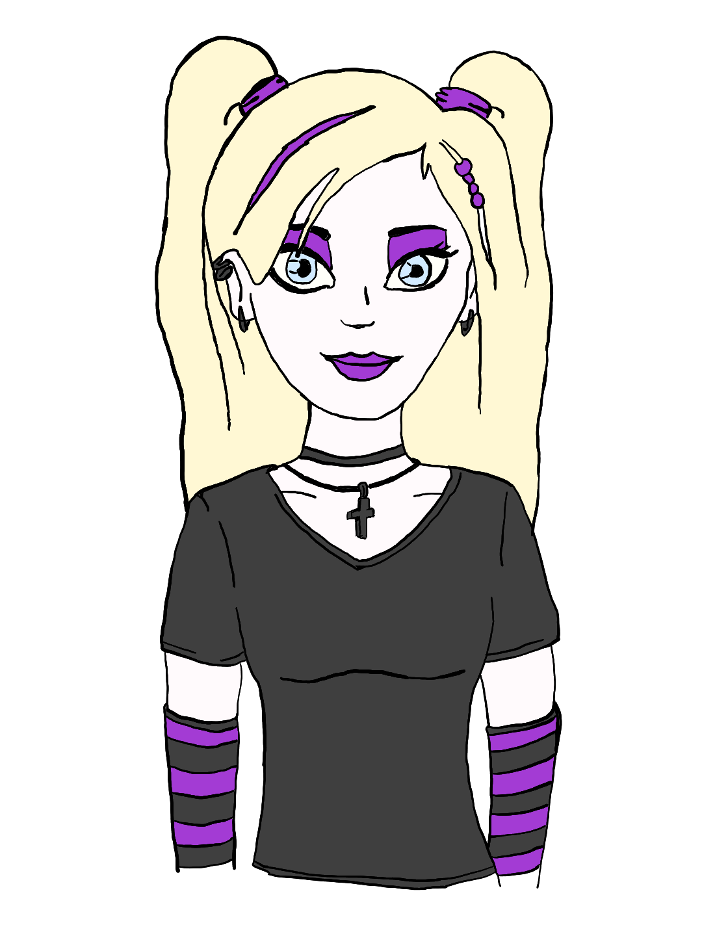
This is Emily. She’s a security engineer.
Profile
Used to be a developer, then got into pentesting
Got bored of breaking stuff and wanted to start fixing things
Wants to help people build awesome and secure services
Privacy and digital rights advocate
Image credit: Rebecca Manning

Slide 96
Hi Emily, I’m Mark. Tara and I were wondering if you could take a look at a design. We need to know there aren’t any obvious security problems.
Absolutely! I can take a look, or we could even try threat modeling it.
Threat modeling? What’s that?

Slide 97
Well, there are lots of different ways to threat model, but it essentially involves findings threats and deciding what to do about them. A great starting point is to ask 4 questions: What are you building?
What can go wrong?
What are you going to do about it?
Are you doing a good job of answering the above 3 questions.

Slide 98
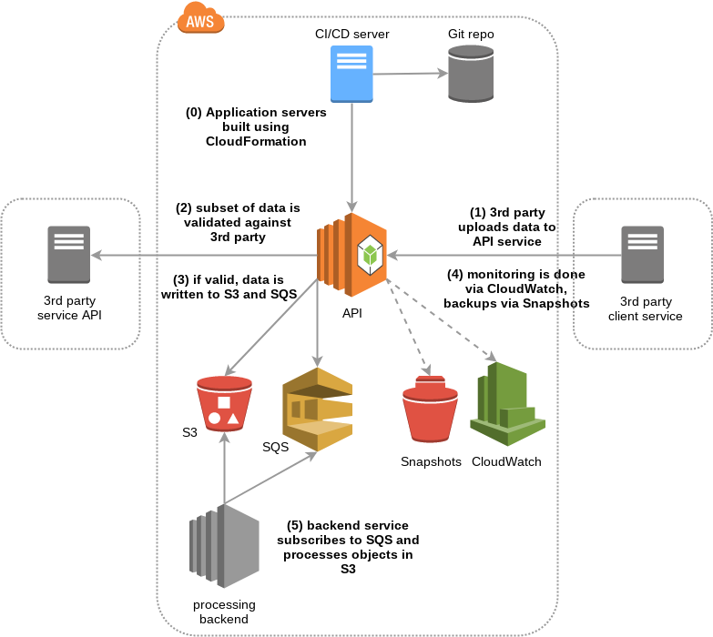
What’s building all of this stuff in the cloud?

Slide 99
So now we know what we’re building, let’s add some trust boundaries. These are demarcation points between different levels of privilege, access or security concern.

Slide 100
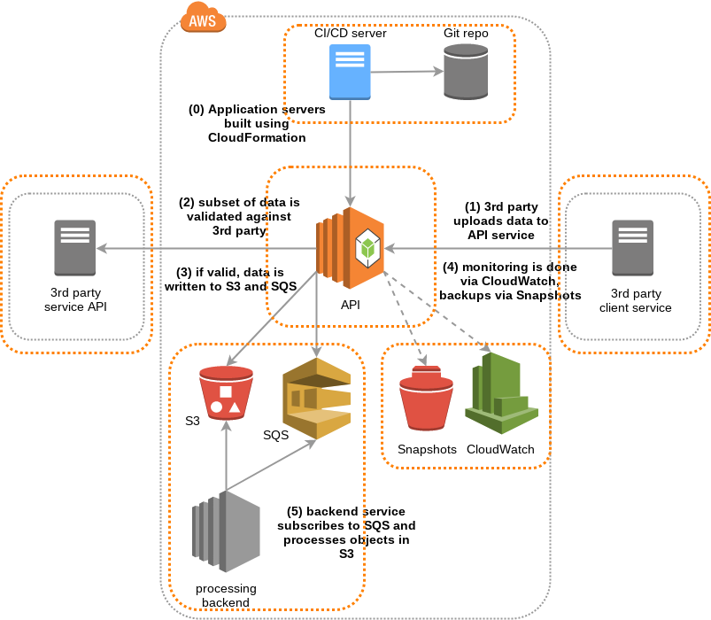
Now we also have some trust boundaries

Slide 101
Now we need to think about possible threats. As you’re using various cloud services, we could look at the OWASP Cloud Security project to see if any of those threats are relevant.
What’s that?
It’s a growing collection of cloud threats and mitigations expressed as BDD stories.
Oh cool! I’m a huge fan of BDD!

Slide 102
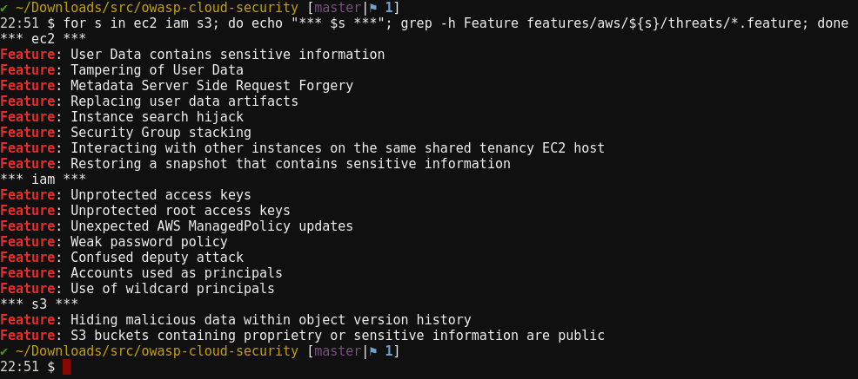
Notes:
OCST-1.1.1 - sensitive data in user data (build)
OCST-1.1.8 - recovering stored snapshot (backups)
OCST-1.3.1 - unprotected IAM access keys (git)
OCST-1.2.2 - private buckets are public (customer data)

Slide 103
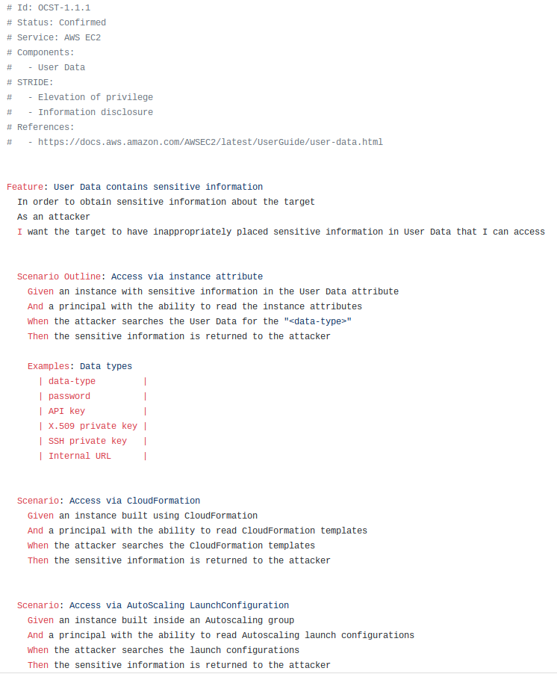
Metadata stored as YAML within comments
The threat
Attack scenarios

Slide 104
# Id: OCST-1.1.1
# Status: Confirmed
# Service: AWS EC2
# Components:
# - User Data
# STRIDE:
# - Elevation of privilege
# - Information disclosure
# References: # - https://docs.aws.amazon.com/...

Slide 105
Feature: User Data contains sensitive information
In order to obtain sensitive information about the target
As an attacker
I want the target to have inappropriately placed sensitive information in User Data that I can access
Scenario: Access via CloudFormation
Given an instance built using CloudFormation
And a principal with the ability to read CloudFormation templates
When the attacker searches the CloudFormation templates
Then the sensitive information is returned to the attacker

Slide 106
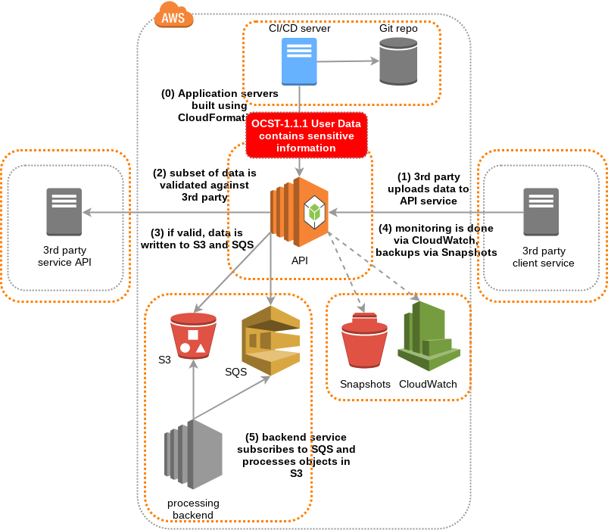

Slide 107
@aws @ec2
Feature: User Data does not contain sensitive information
In order to prevent exposure of sensitive or proprietary information
As an engineer
I want to avoid putting sensitive information in User Data

Slide 108
Feature: Restoring a snapshot that contains sensitive information
In order to retrieve sensitive instance data
As an attacker
I want to restore snapshots into an instance I control
Scenario: Restoring a snapshot
Given an EBS snapshot for an instance containing sensitive information
And an instance that the attacker controls
And a principal with the allowed permissions needed to read and restore snapshots
| action | description |
| ec2:DescribeSnapshots | Get a list and details of the available snapshots |
| ec2:CreateVolume | Creates a new volume from the snapshot |
| ec2:AttachVolume | Attach the new volume to the EC2 instance |
When the attacker restores the snapshot to the instance
And the attacker searches the snapshot filesystem for interesting data
| data |
| credentials |
| private keys |
| log files |
Then the sensitive information is returned to the attacker

Slide 109
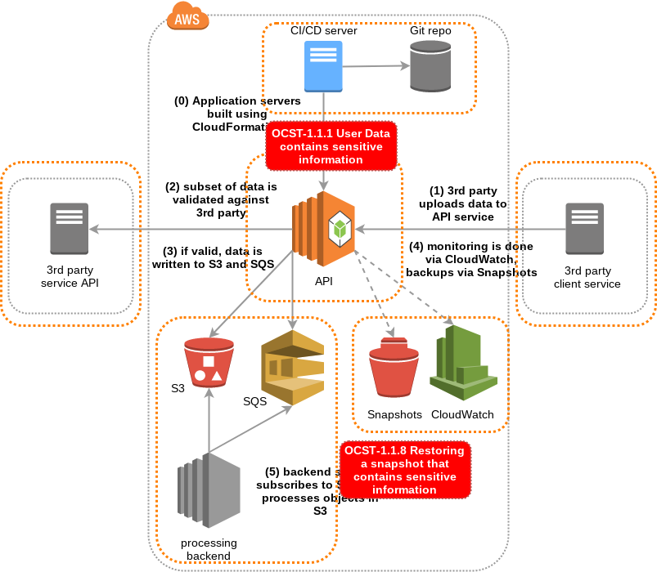

Slide 110
In order to prevent unauthorised access to Snapshot backups As an engineer I want to limit the roles that have the ability to read and restore snapshots

Slide 111
Feature: S3 buckets containing proprietary or sensitive information are public
In order to get access to secret, sensitive or customer data
As an attacker
I want companies to accidentally make private S3 buckets public
Scenario: Discovering public buckets using Bucket Finder
Given an S3 bucket containing sensitive information
And the bucket has a predictable global name
And a wordlist of possible bucket names
When Bucket Finder is executed using the wordlist
Then the public bucket is found
And the contents is available to download

Slide 112
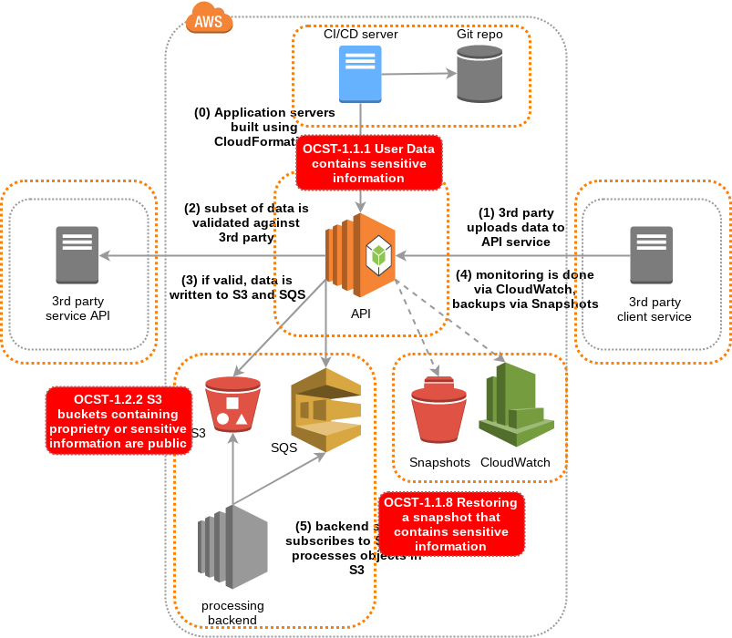

Slide 113
In order to prevent accidental exposure of sensitive data via a public S3 bucket As an engineer I want to ensure private buckets cannot be made public And I want detective controls in place to find public buckets

Slide 114
Feature: Unprotected access keys
In order to gain additional access to resources in an account
As an attacker
I want to find unprotected API access keys
Scenario Outline: Finding exposed access keys
Given a principal with existing API access keys
And a <storage-system>
When the user stores their access keys in the <storage-system>
And the attacker scans the <storage-system> for access keys
Then the attacker finds the access keys
And the attacker can use the access keys to access resources in the target account
Examples: Non-exhaustive list of possible storage systems
| storage-system |
| S3 bucket |
| Git repository |
| Filesystem with weak protection |
| Wiki or documentation system |
| Email or other communication platform |

Slide 115
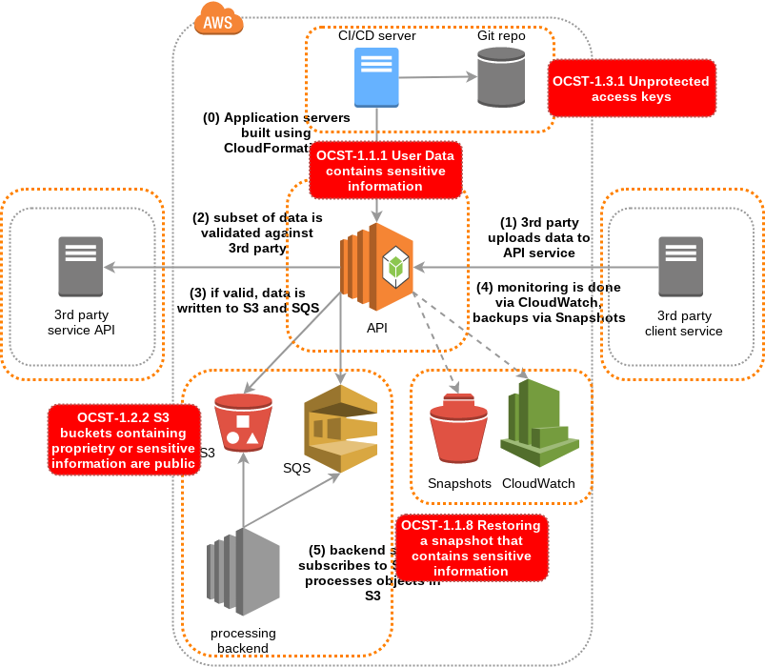

Slide 116
In order to prevent exposure of privileged IAM access keys As an engineer I want to use instance profiles and locked down IAM policies

Slide 117
What about SQS? Also, this service could possibly be built using Lambda, should we threat model that too?
We’re running out of time for today. You could start scheduling regular threat modeling sessions, for example after every sprint planning. If you need me to join or facilitate, I’d be more than happy to.

Slide 118
Thanks for offering to help. I’ll speak to Rajesh who is our product owner about scheduling time to threat model.
That would be fantastic. Your product owner should be involved in every aspect of threat modeling as ultimately own the risks and are key to prioritising any mitigation efforts.

Slide 119
If we found interesting threats for SQS and Lambda, could we contribute them back to the project?
Yes! It’s a community-driven project. The more contributions it gets, the more value it can provide to everyone.
Great! I’m looking forward to our next threat modeling session. It has been great working so closely with the security team. Thank you!

Slide 120
Hands-on: Group threat story
Simple 3 tier website
Mobile phone privacy
Using an online password manager

Slide 121
Example: 3-tier website

Slide 122
Example: Mobile phone privacy

Slide 123
Example: Password manager

Slide 124
Individual threat story writing
Serverless (e.g AWS Lambda)
Containers (e.g. AWS ECS)
Non-Cloud of your choosing

Slide 125
Go do awesome
Start using BDD in your organisation
Start threat modeling
Contribute to the OWASP Cloud Security project

Slide 126
Thank You
If you would like to get involved in the OWASP Cloud Security project:
@OWASP_CloudSec on twitter
#cloud-security on the OWASP Slack
Submit a Github issue or pull request!
https://owasp.org/index.php/OWASP_Cloud_Security_Project

Slide 127
Thanks
Thanks to Omer Levi Hevroni for the original workshop idea
Thanks to Siren for reviewing slide drafts
Thanks to everyone who has contributed to the project
Thanks t you for participating in this workshop!

Slide 128
Further reading
https://www.owasp.org/index.php/Application_Threat_Modeling
https://www.owasp.org/index.php/OWASP_Threat_Model_Project
https://automationpanda.com/bdd/
https://www.continuumsecurity.net/bdd-security/
http://gauntlt.org/

